Slide 1
Preliminary Multiple Regression Analysis of Lake Superior Water Budget Components
Coordinating Committee Great Lakes Basic Hydraulic and Hydrologic Data
Buffalo, New York, USA, Nov. 5, 2014
Dave Holtschlag, USGS, and Vincent Fortin, EC

Slide 2
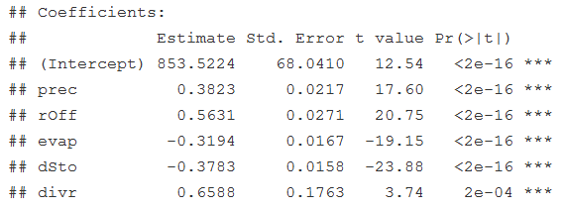

Multiple Regression for Predicting St. Marys River Flow
Key to Variable Names:
--------------------------------
stmr: St. Marys River
prec: Overlake precipitation
rOff: Basin runoff
evap: Overlake Evaporation
dSto: Change in lake storage
divr: Diversions into Lake
Superior

Slide 3
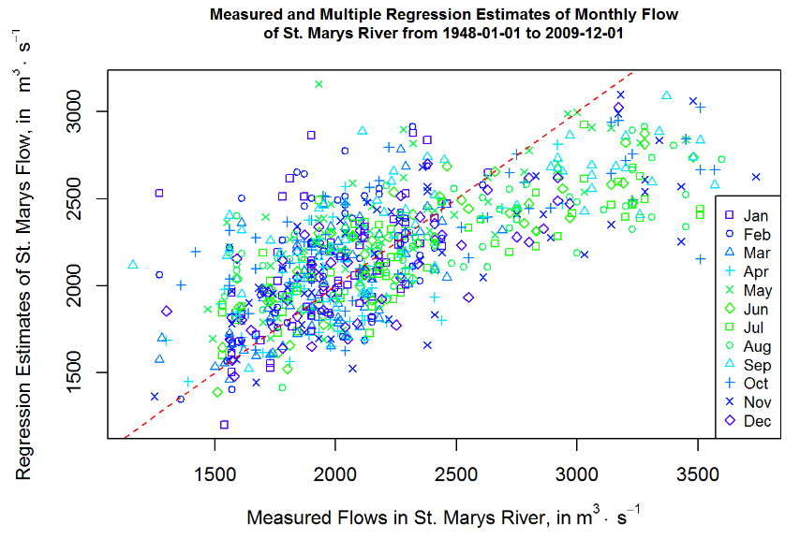
Prediction with Multiple Regression
Line of agreement
High flows underestimated

Slide 4
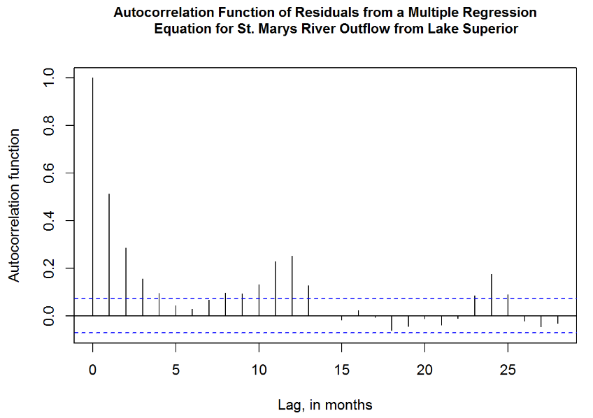
ACF of Multiple Regression Model
Threshold for significant autocorrelation

Slide 5
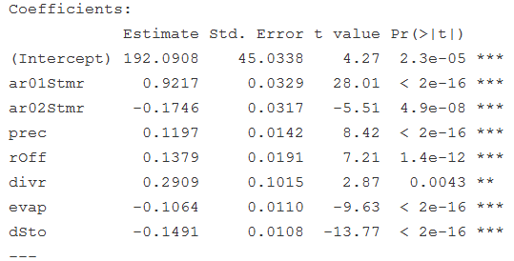
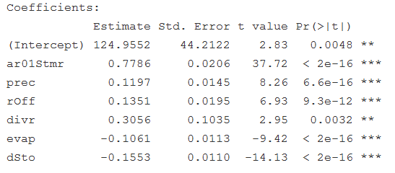


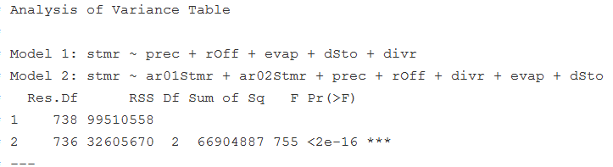
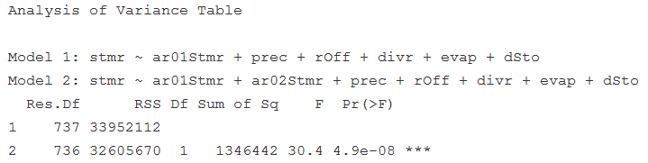
Autoregressive (AR) Multiple Regression Models
Compare MultReg with AR₂
Compare AR₁ with AR₂
ar01Stmr: lag₁ St. Marys River Flows; ar02Stmr: lag₂ St. Marys River Flows.

Slide 6
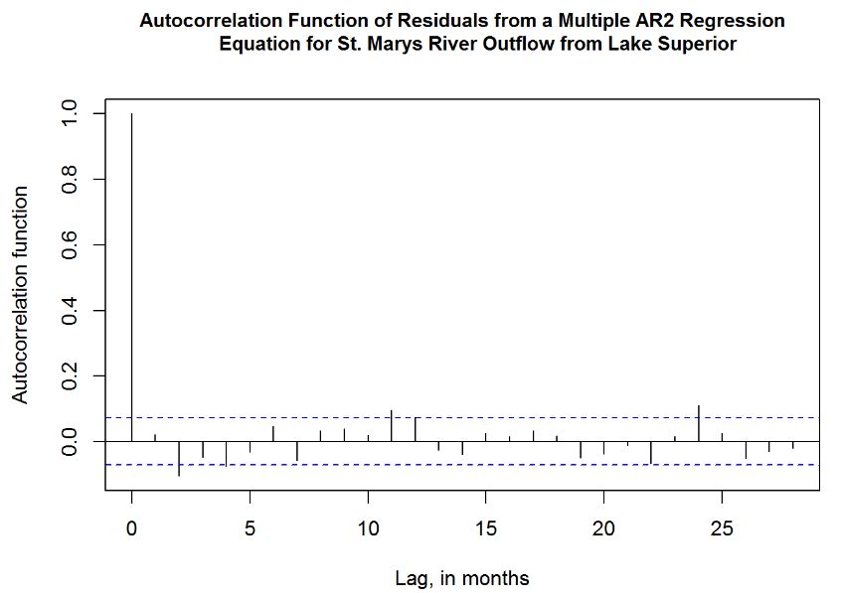
ACF of AR Multiple Regression Model
Autocorrelation Function of AR2 Model Residuals shows no correlation.

Slide 7
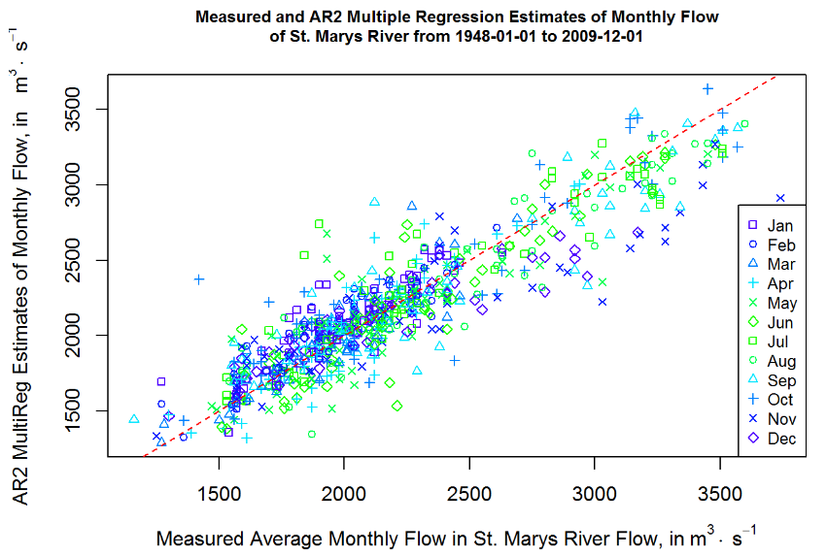
AR2 Multiple Regression Prediction
Problem of under prediction reduced.

Slide 8
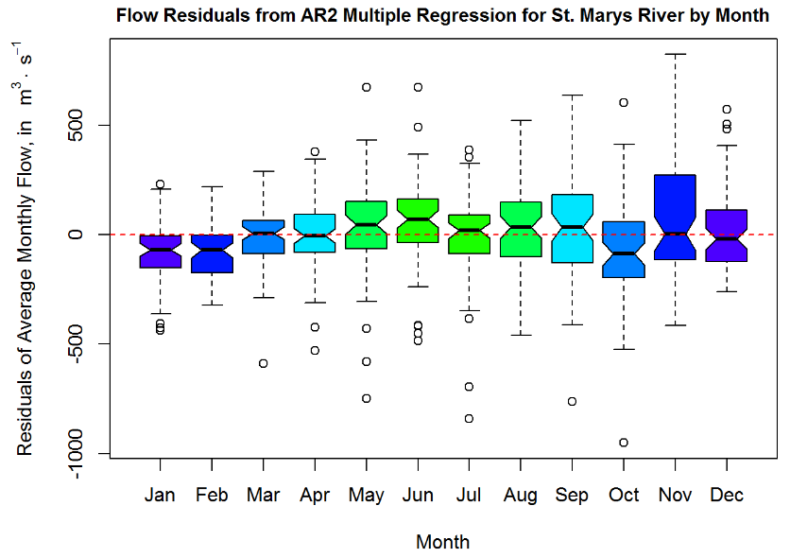
Distribution of Residuals by Month
Possible bias in Jan
and Feb residuals

Slide 9
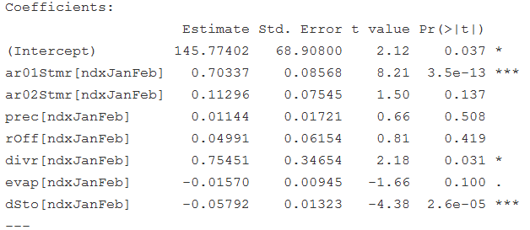
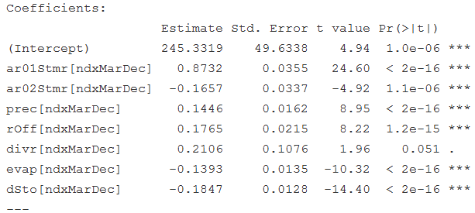


Seasonal Model: Jan-Feb and Mar-Dec
AR2 Multiple Regression for Jan-Feb
AR2 Multiple Regression for Mar-Dec

Slide 10
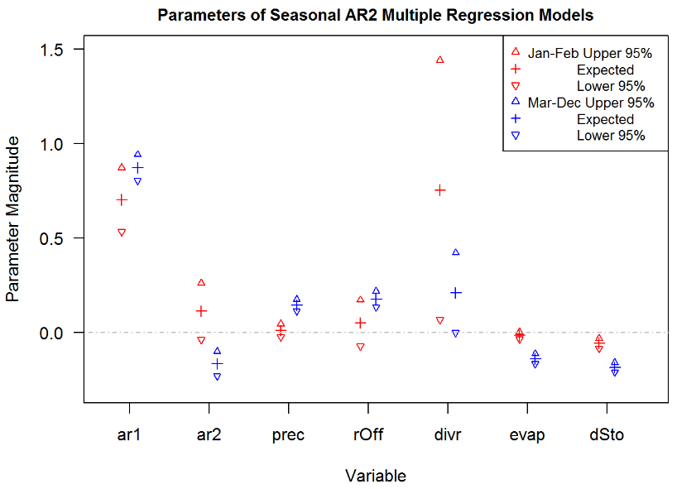
Seasonal Model Parameter Comparison

Slide 11
Preliminary Conclusions
Multiple Regression Model
Parameters signs are consistent with physical processes
Explains about 46.4 % of St. Marys Flow Variability
Under estimates higher flows over predicts lower flows
Autocorrelated Residuals
Autoregressive Multiple Regression Model
Both AR₁ and AR₂ improve model prediction
Adj-R²: AR₁(0.817) and AR₂(0.824)
ANOVA(AR₁, AR₂) = 4.9x10⁻⁸
Seasonal Component in AR₂ Model
Jan-Feb Parameters differs from Mar-Dec Parameters
Jan-Feb parameters for AR2, prec, rOff, and evap are marginally significant
Jan-Feb model may indicate a need to account for thermal expansion
https://github.com/dholtschlag-usgs/LakeSuperior

